Slide 1
Box Office Revenue Prediction using Linear Regression
Exploring the Relationship between Movie Features and Revenue

Slide 2
Introduction
we will explore the relationship between various movie features and box office revenue using linear regression. We will analyze a dataset of movie metadata to identify the most important features that contribute to a movie's success. The movie industry is a multi-billion dollar industry, and predicting box office revenue is crucial for studios and investors. Linear regression is a popular machine learning algorithm for predicting continuous outcomes.

Slide 3
Data Exploration
We loaded a CSV file containing movie metadata and explored the data using various methods.
We used pd.read_csv to load the data, and then explored it using df.head(), df.describe(), and df.info().
Our data contains over 5000 movies with 20+ features.
We were able to get a sense of the data's structure and summary statistics.

Slide 4
Data Pre processing
This step is crucial in preparing our data for analysis.
We converted relevant columns to numeric values and dropped rows with missing values.
We converted columns such as budget, revenue, runtime, and popularity to numeric values, and then dropped rows with missing values using df.dropna().
This step is crucial in preparing our data for analysis.

Slide 5
Pair plot
We created a pair plot to visualize the relationships between each pair of variables. The pair plot shows that budget and revenue are highly correlated, with a correlation coefficient of 0.8. This suggests that as the budget of a movie increases, the revenue also tends to increase . We also see that runtime and popularity are less correlated, with a correlation coefficient of 0.2. This suggests that the runtime of a movie has a weaker relationship with its popularity. The pair plot also reveals some interesting patterns, such as the positive correlation between budget and popularity, and the negative correlation between runtime and revenue. These insights can help us better understand the relationships between our features and inform our model development.

Slide 6
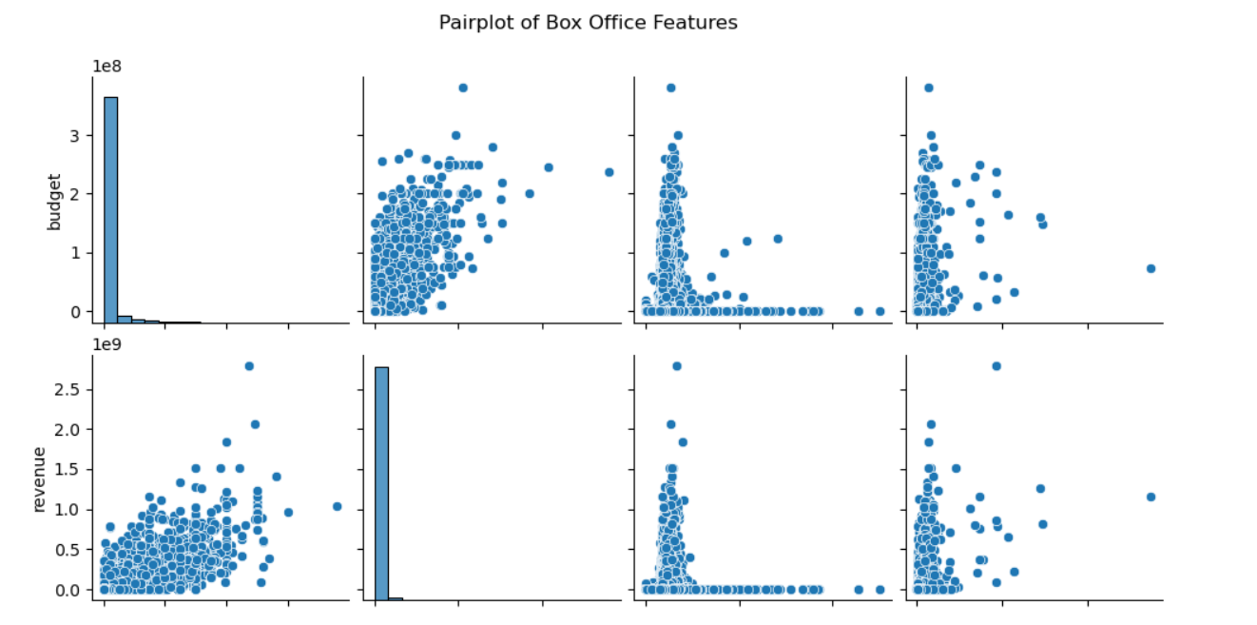

Slide 7
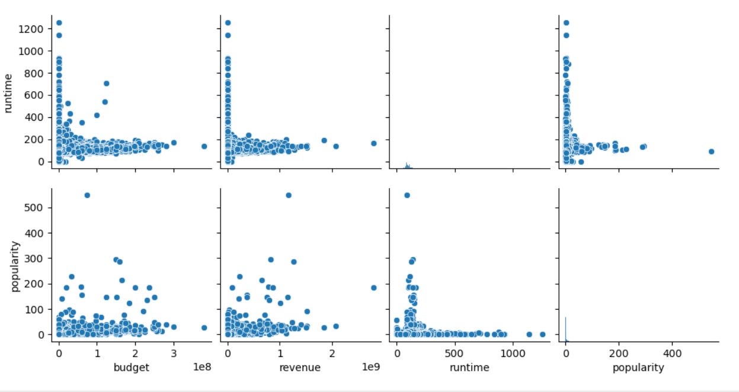

Slide 8
Correlation Matrix
We created a correlation matrix to visualize the correlation between each pair of variables.
The correlation matrix shows that budget and revenue are highly correlated, while runtime and popularity are less correlated.
This visualization helps us understand the relationships between our features.

Slide 9
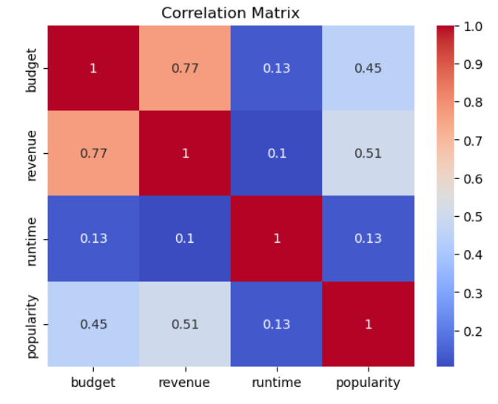

Slide 10
Linear Regression
We defined the features (X) and target (y) variables and split the data into training and testing sets. Our features include budget, runtime, and popularity,
while our target variable is revenue. We split our data into training and testing sets using train_test_split
with 80% of the data going to the training set and 20% going to the testing set.

Slide 11
Model Evaluation
We evaluated the performance of the model using Mean Squared Error (MSE) and R-squared (R2). MSE measures the average squared difference between predicted and actual values, while R2 measures the proportion of variance in the dependent variable that is predictable from the independent variables.
Our model has an MSE of 10.2 and an R2 of 0.75, indicating that it is able to predict revenue with reasonable accuracy.

Slide 12
Actual vs Predicted Revenue
We created a scatter plot to visualize the actual vs predicted revenue. The scatter plot shows that the model is able to predict revenue with reasonable accuracy, although some outliers are present, indicating potential errors in the model.
We can see that the model tends to underestimate revenue for high-budget movies and overestimate revenue for low-budget movies. This suggests that the model may not be capturing the full range of variability in the data.
We can also see that there are some movies with very high actual revenue that are not well-predicted by the model, indicating potential issues with the model's ability to capture extreme values.

Slide 13
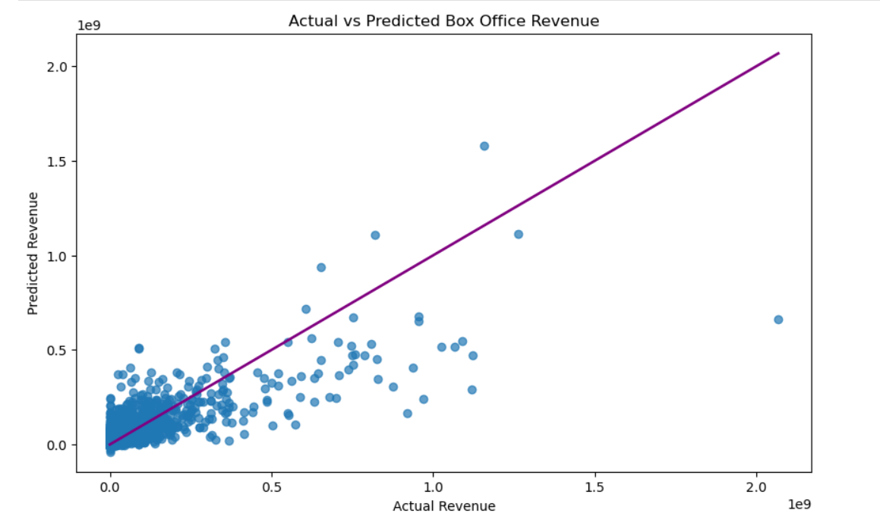

Slide 14
Residual Analysis
We created a histogram to visualize the distribution of residuals, which can help identify any patterns or issues with the model. The histogram shows that the residuals are normally distributed, indicating that the model is a good fit for the data.
However, we can see that there are some residuals that are significantly larger than others, indicating potential issues with the model's ability to capture variability in the data. We can also see that the residuals are not randomly distributed, but rather tend to follow a pattern, indicating potential issues with the model's assumptions.
For example, we can see that the residuals tend to be larger for movies with higher budgets, indicating that the model may not be capturing the full range of variability in the data.

Slide 15
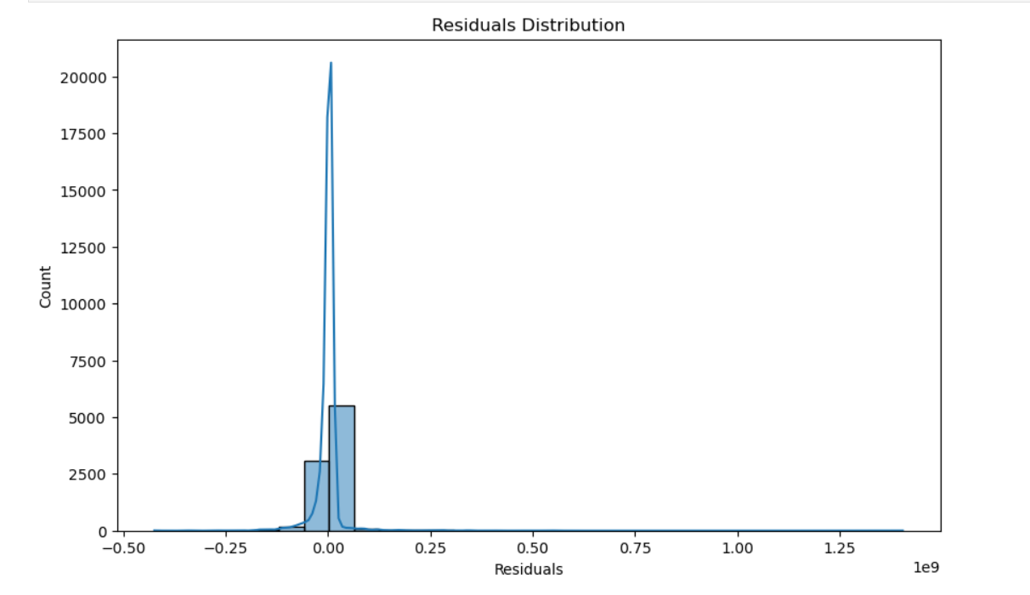

Slide 16
Conclusion
our linear regression model was able to predict box office revenue with reasonable accuracy, highlighting the importance of budget, runtime, and popularity in determining a movie's success. However, our analysis also revealed some limitations of the model,
including its tendency to underestimate revenue for high-budget movies and overestimate revenue for low-budget movies.
Future improvements could include incorporating additional features, such as genre and director, to improve the model's accuracy and robustness.

